Slide 1
Reminder: sample problem
Housing Prices
(Portland, OR)
Price
(in 1000s of dollars)
Size (feet²)

Slide 2
Reminder: Notation
Training set of
housing prices
(Portland, OR)
Size in feet² (x) | Price ($) in 1000's (y)
2104 | 460
1416 | 232
1534 | 315
852 | 178
… | …
Notation:
m = Number of training examples
x’s = “input” variable / features
y’s = “output” variable / “target” variable

Slide 3
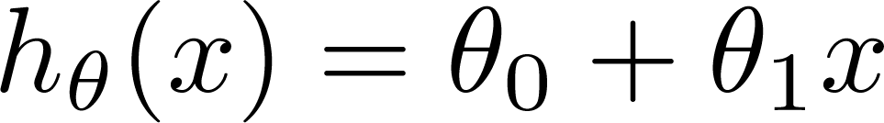
Reminder: Learning algorithm for hypothesis function h
Training Set
Learning Algorithm
Linear Hypothesis:
Size of house
h
Estimate price
Univariate linear regression)

Slide 4
Reminder: Learning algorithm for hypothesis function h
Training Set
Learning Algorithm
Linear Hypothesis:
Size of house
h
Estimate price
Univariate linear regression)

Slide 5
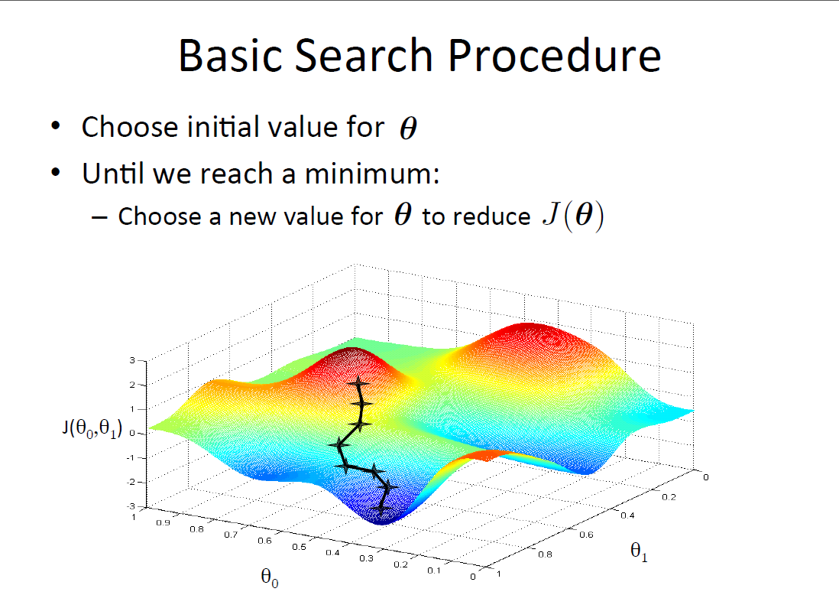

Slide 6
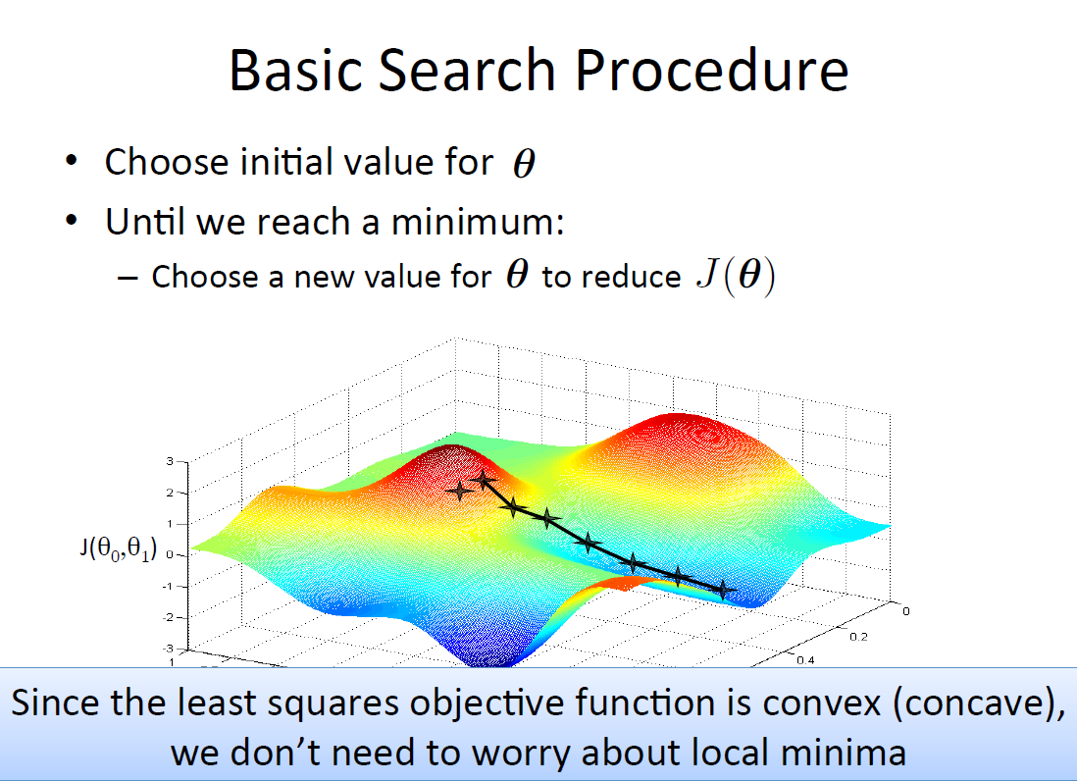

Slide 8
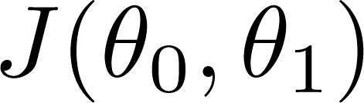
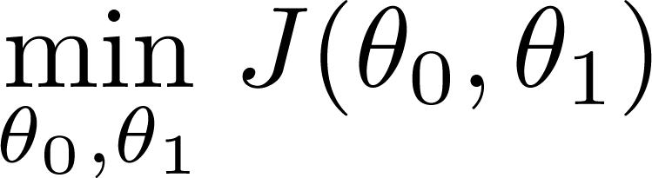
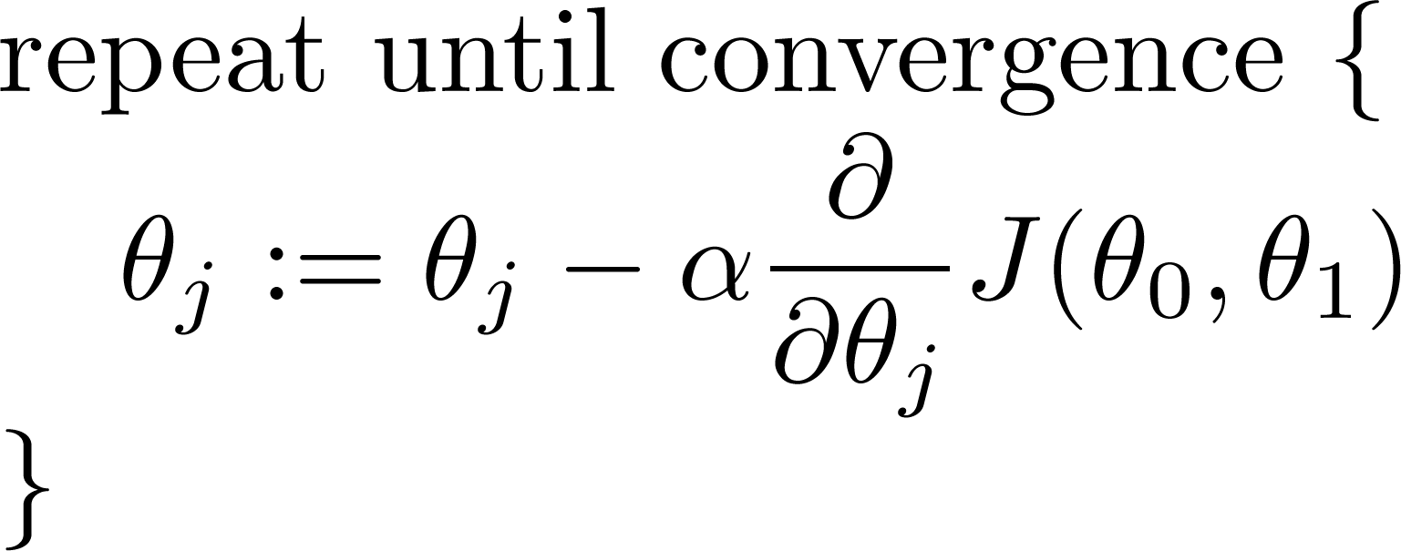
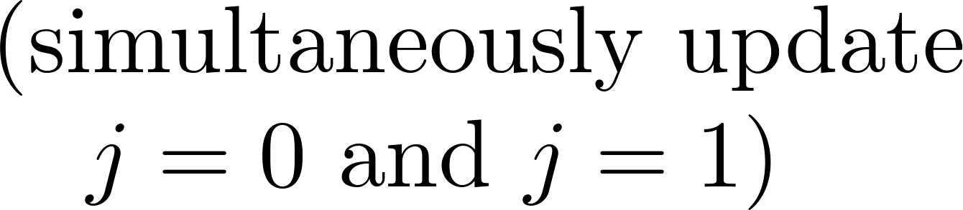
Gradient Descent
Have some function
Want
Gradient descent algorithm
learning rate

Slide 9
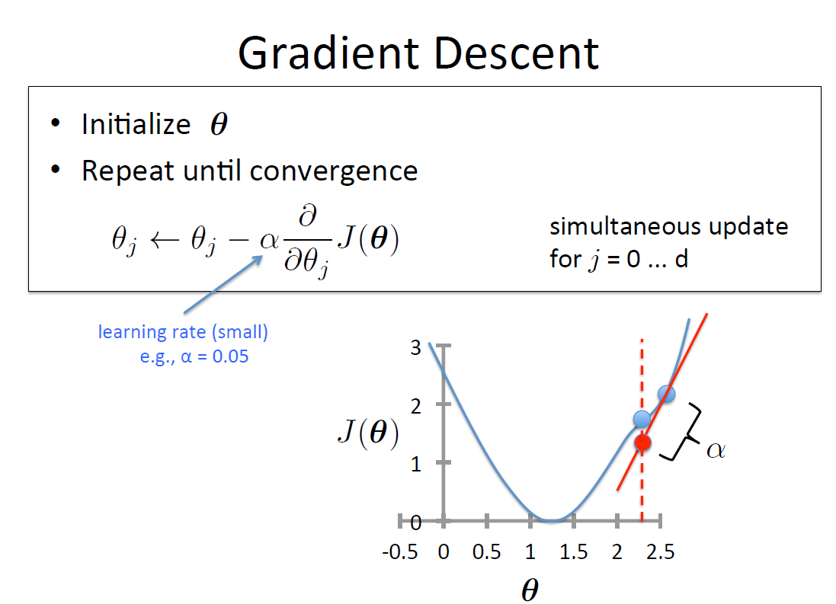

Slide 10
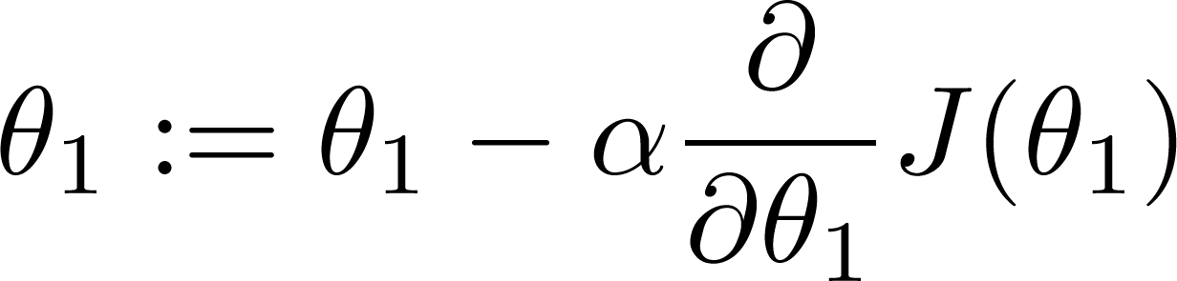
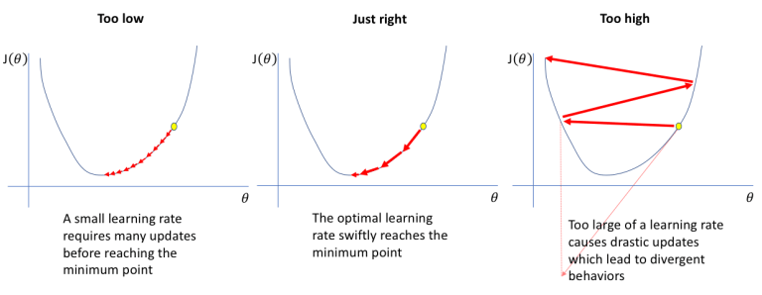
If α is too small, gradient descent can be slow.
If α is too large, gradient descent can overshoot the minimum. It may fail to converge, or even diverge.

Slide 11
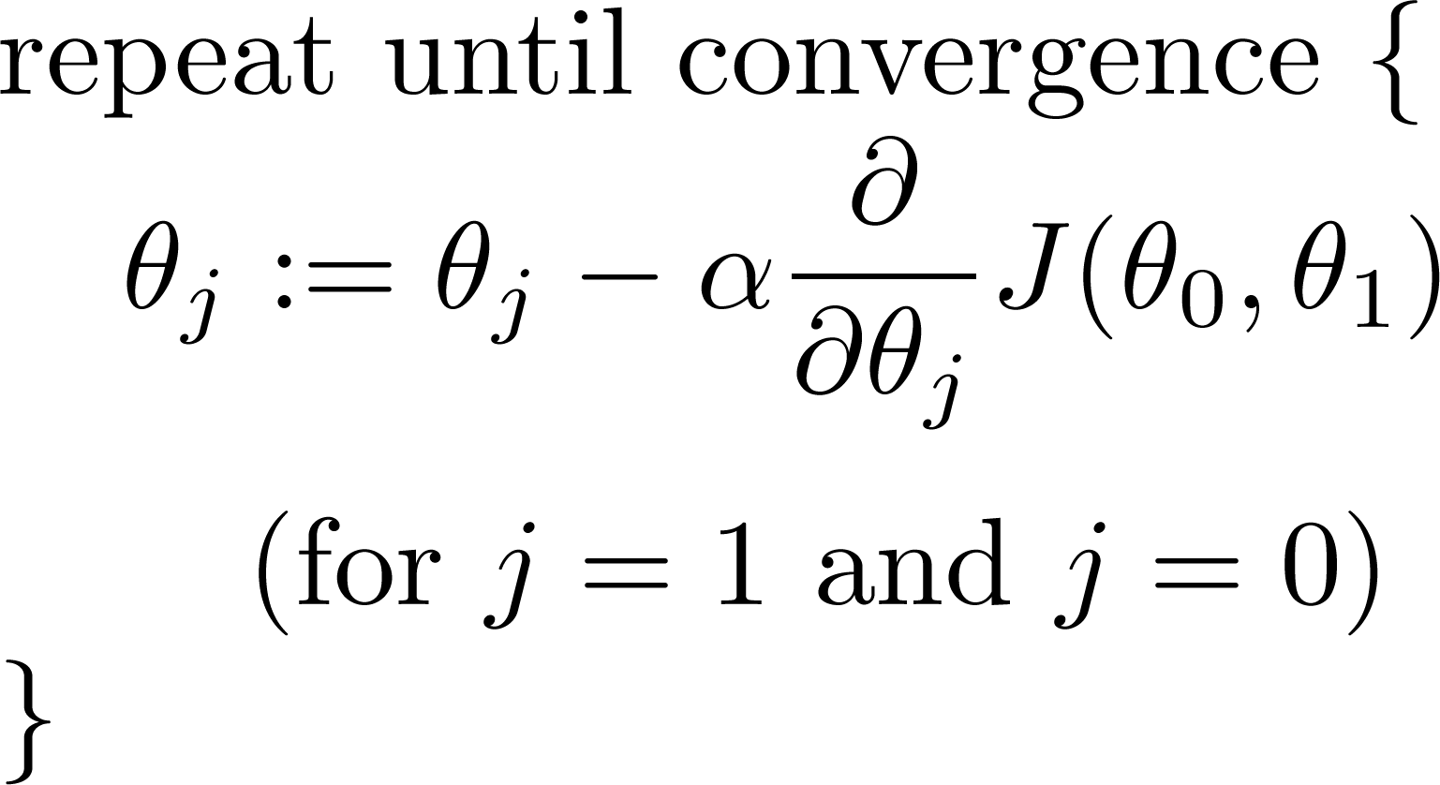
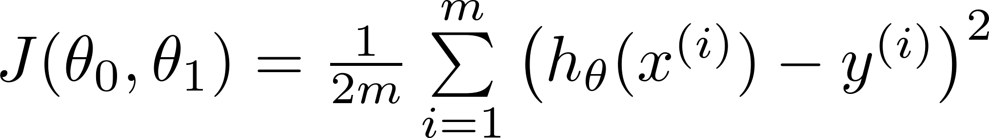
Gradient descent algorithm
Linear Regression Model

Slide 12
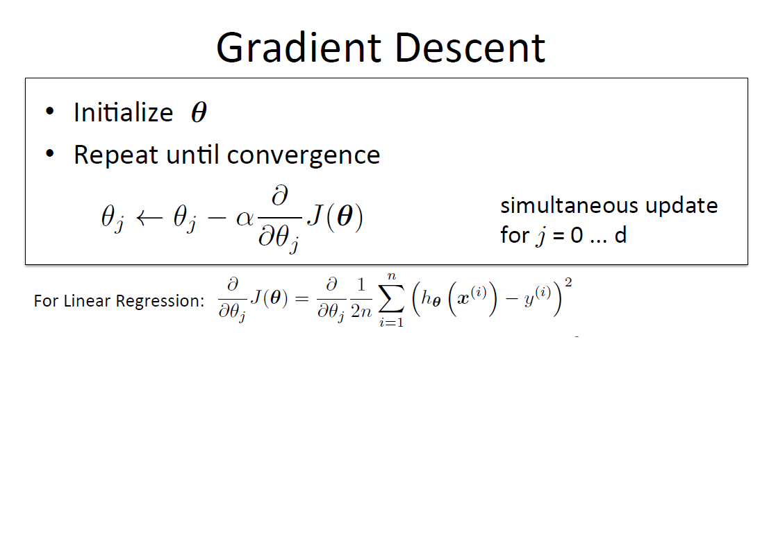

Slide 13
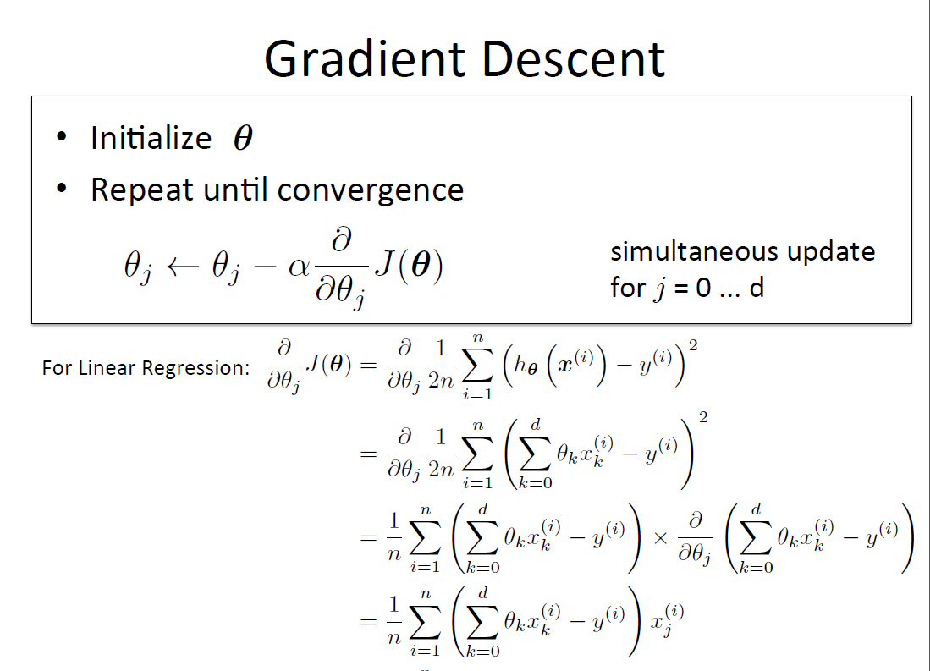

Slide 14
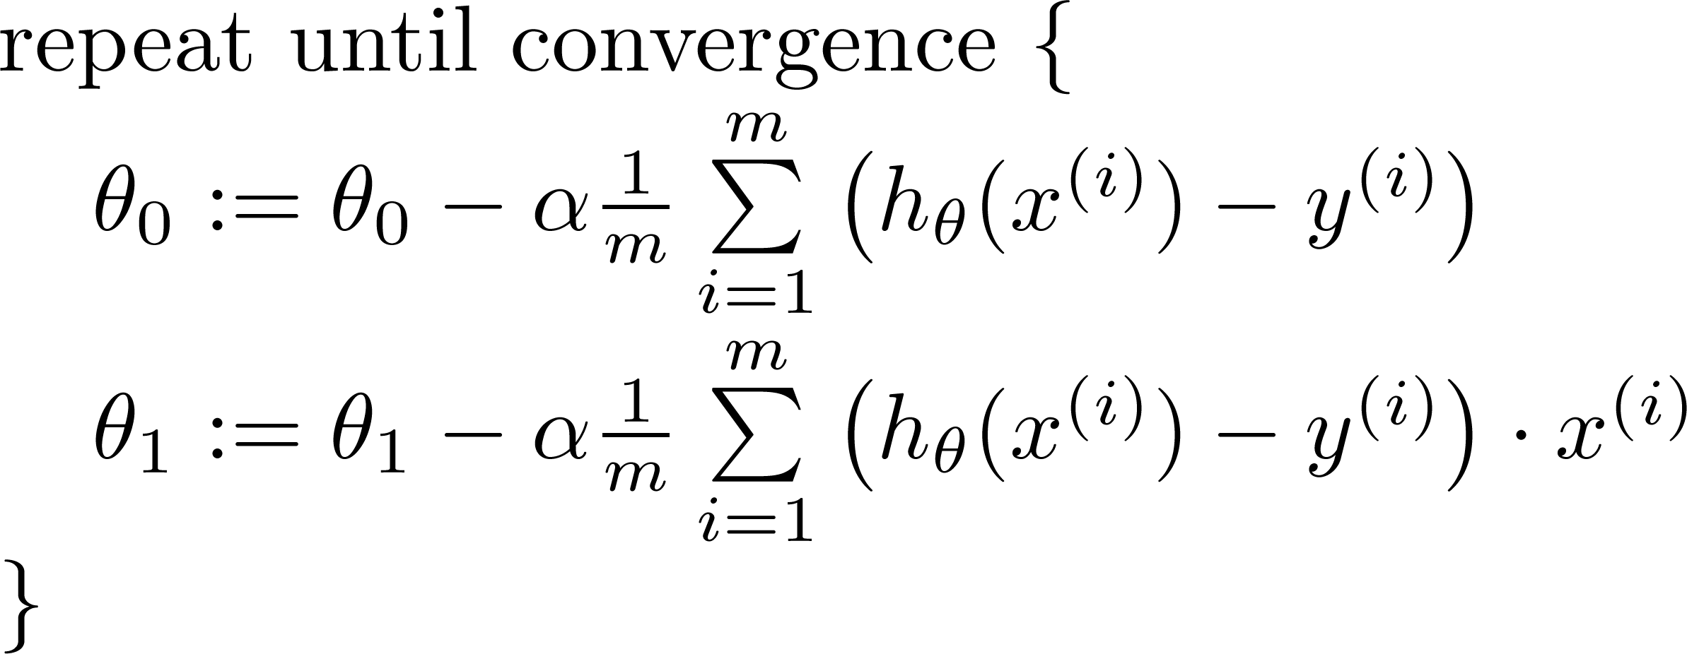


Gradient descent algorithm
update
and
simultaneously

